Slide 1
Digital Portfolio
STUDENT NAME:DIVYASRI S
REGISTER NO :212402829
NMID:14007B7EED046898D443E54D7BF403
DEPARTMENT: BCA
COLLEGE:SRM ARTS AND SCIENCE COLLEGE CHENGALPATTU/MADRAS UNIVERSITY

Slide 2
PROJECT TITLE
Digital Portfolio Website for Academic and Career Growth

Slide 3


AGENDA
Problem Statement
Project Overview
End Users
Tools and Technologies
Portfolio design and Layout
Features and Functionality
Results and Screenshots
Conclusion
Github Link
3/21/2024 Annual Review

Slide 4

PROJECT OVERVIEW
This project is a personal portfolio website created to highlight my academic achievements, technical skills, and personal interests in an organized digital format. The website has been designed with a clean structure, allowing visitors to easily navigate through different sections such as education, skills, languages, hobbies, and resume. By presenting information in a professional yet simple way, the portfolio acts as a central platform where anyone can quickly understand my background, strengths, and aspirations. It is developed using basic web technologies and is hosted online so that it remains accessible anytime and anywhere.

Slide 5

WHO ARE THE END USERS?
The primary end users of this digital portfolio are students, recruiters, teachers, and mentors. Students and peers can explore my academic background and technical journey for collaboration and learning. Recruiters and employers can quickly assess my skills, education, and resume to evaluate my suitability for opportunities. Teachers and mentors can review my progress and strengths to provide guidance. Additionally, the portfolio is open to a general audience, allowing anyone interested to learn more about my profile and personal interests.

Slide 6

PROBLEM STATEMENT
In today’s digital world, it is no longer enough to depend only on a printed resume or traditional methods to showcase skills and achievements. These documents are often static, lack creativity, and fail to reflect a student’s personality. There is a clear need for a personalized digital portfolio that can present academic records, technical expertise, and personal interests in a way that is both engaging and interactive. This project attempts to solve that problem by providing a website that combines professionalism with accessibility.
.

Slide 7

TOOLS AND TECHNIQUES
The development of this portfolio website makes use of fundamental web technologies like HTML, CSS, and JavaScript to structure and style the pages. Alongside this, scripting knowledge in Python and C++ has helped in building a stronger technical foundation. The website is hosted on GitHub Pages, which provides a free and reliable platform for deployment and maintenance. The design approach focuses on simplicity, readability, and user-friendly navigation, ensuring that the portfolio remains both professional and easily accessible across different devices.

Slide 8
POTFOLIO DESIGN AND LAYOUT
The design and layout of the portfolio are kept minimalistic yet structured to ensure a professional appearance. The homepage introduces the student with basic details and an overview, followed by neatly arranged sections for education, skills, languages, and hobbies. Each section is carefully presented to maintain clarity and flow. At the end, there is a resume section with a button for downloading or printing, allowing easy access for recruiters or mentors. The overall layout maintains consistency, making sure the visitor has a smooth experience while navigating through the website.
8

Slide 9
FEATURES AND FUNCTIONALITY
The portfolio website comes with a number of useful features to improve its functionality. It is responsive in design, meaning it adapts well to different screen sizes such as laptops, tablets, and mobile phones. It includes an option to download or print the resume directly, which is especially helpful for recruiters. The navigation between sections is clear and simple, avoiding clutter and making information easy to find. Each part of the website is structured to highlight academic achievements, technical skills, and personal qualities in a way that makes the profile more impactful.

Slide 10

RESULTS AND SCREENSHOTS
The final result of this project is a professional and user-friendly portfolio website that effectively brings together academic details, technical expertise, and personal interests in one place. The homepage provides a quick introduction, while the skills and education sections give recruiters and mentors a clear view of my qualifications. The resume button ensures that important documents can be downloaded instantly. Screenshots of the homepage, the education and skills sections, and the resume download feature demonstrate how the portfolio is structured and how it appears to the end user.
3/21/2024 Annual Review
10

Slide 11
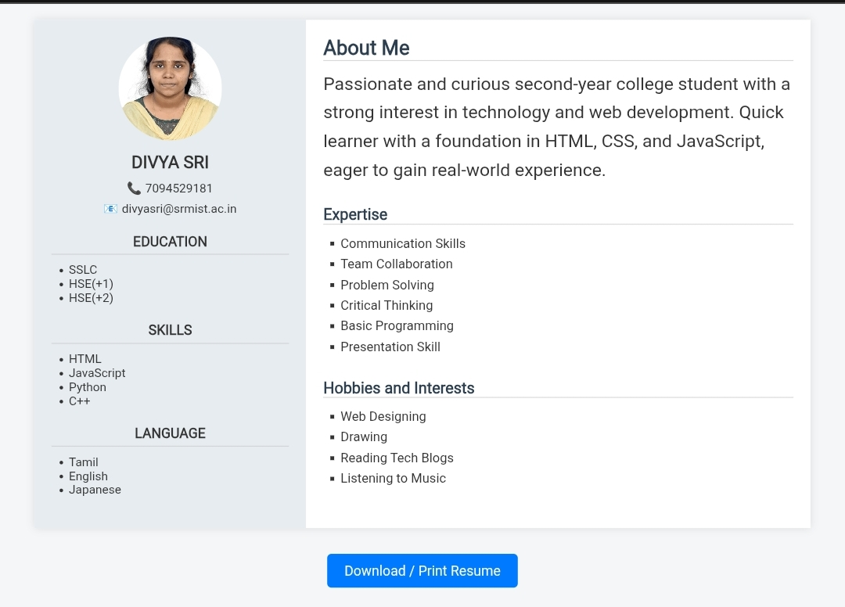

Slide 12
CONCLUSION
In conclusion, this project successfully delivers a well-structured personal portfolio website that combines professionalism with accessibility. It provides me with an effective platform to present my achievements, skills, and personal interests in a way that a traditional resume cannot. The portfolio serves not only as an academic and career tool but also as a personal space where I can express my growth and aspirations. By having this website available online, I ensure that my profile is visible to a larger audience, opening up opportunities for career advancement and professional connections.
12

Slide 13
GITHUB LINK
click here:
https://divyasris-bca.github.io/nm

